Slide 1
Elm Street Learning
By H.O.R.N.E.T.

Slide 2
Who We Are:
Elm Street Learning is an entity of HORNET Inc., that provides education and training focused in the area of healthcare. At ESL we are notably known for our online 30- and 90-day LTC online nurse residency program.
Purpose: To provide a premier platform for all aspects of healthcare education, training and networking .

Slide 3
LTC Online Nurse Residency
From a Novice-Newbie to an Evolving Expert! The LTC Nurse Residency Program: An online program platform designed to provide new long-term care nurses the knowledge, experience, skills and confidence necessary to be successful in the ever-changing complex, yet rewarding world of healthcare from a long-term care perspective.

Slide 4
The Online Nurse Residency Programs:
Clients have the option of the 30-Day Nurse Residency program, or the 90-Day Nurse Residency program. Most of the same material is covered in both programs, however with the 90-Day Selection, the client has more time to complete the material at his or her own pace, with online feedback and support, as well as an assigned online mentor; there are 7 additional pertinent to LTC, courses presented in the 90- day program.
We also have a track for an accelerated 3-day program for the new nurse or the nurse newly starting at a facility, which will satisfy required orientation training courses.
The 3, 30 and 90-day training course provides the learner with all the tools and information needed to be successful, while freeing up the facility from one-on-one training allowing the host facility (your organization) time to focus on other areas of need.
Let the experts train your team!

Slide 5
30 Day Nurse Residency Courses
A Day in the Eyes of the LTC nurse: Introductory Course
Residents Rights
Preventing Resident Abuse, Neglect and Exploitation
Medication Management & Administration
Falls Prevention & Management Program
Infection Prevention & Control
Pain Management
HIPAA
Diets and Nutrition
Workplace Safety – Safety Matters
Wound Care Prevention & Management
The Admission’s Process
Managing Labs: The Process
The Death Process
The Elder Justice Act
Communication & Customer Service in Healthcare
The Code Blue
Understanding Restorative, Nursing & ADLs
The E-Interact Tool & SBAR
Documentation: Do’s & Don’ts
Antibiotic Stewardship
The Alzheimer’s/Dementia Resident
Emergency Preparedness
Bloodborne Pathogens
Advance Directives: What you Should Know
From the Novice Newbie to the Evolving Expert
Recognizing a Change in Condition

Slide 6
90-Day Nurse Residency Courses
All the courses included in the 30-Day Program in addition to:
Online workshops and exercises with real-like scenarios designed to increase the novice nurse’s critical thinking and judgement skills.
Cultural Diversity
Recognizing a Change in Condition
Person Centered Care
The Care Plan and MDS
The Active Shooter
Dealing with the Difficult Resident
First Aid & Choking
Oral Care

Slide 7
Certificate of Completion:
After completing the program, the nurse will receive a certificate of completion. A competency evaluation follows completion of most individual courses.
The courses may be used for annual training and education.

Slide 8
Benefits of the Residency Program
We all understand how busy nursing facilities are, and at times may be experiencing a shortage in staff readily available to provide the necessary training to new staff. Often times new nurses are paired with an experienced nurse at the facility and due to the fast- pace course of the day, the precepting nurse just doesn’t have the time to properly train and show the newbie how tasks really should be done. Let us do the work for you, at a pace in which the new nurse gets to work self-paced and repeat the material as needed throughout the allotted timeframe.
All Thumbs Up!
Non-rushed setting for new nurse
Save time for staff
No more sitting in a traditional orientation and losing focus or falling asleep.
Interactive course sessions
Prepares the new nurse to go directly to the floor and start to work; less time following someone else
Decreases overall nurse turnover rate as nurse feels more confident and prepared to hit the floors running
Courses may be used for annual training

Slide 9
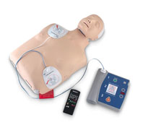
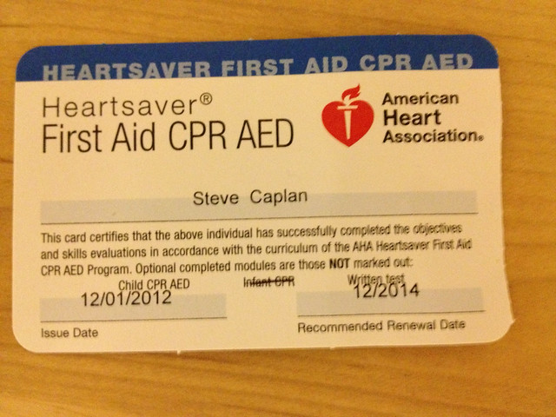
CPR
We provide CPR through the American Heart Association and Red Cross to healthcare providers as well as to laypersons. 2 -year certification.
Classroom setting in person
Online (course lesson online/skills portion must be in person)

Slide 10
Elm Street Learning
Subscribe now: Today’s way of “new nurse” training, or annual training.
Effective
Efficient
Elite
Elm Street

Slide 11
Contact us by: www.elmstreet-learning.com
Phone: 630-569-1942
Email address: sdarden@elmstreet-learning.com

